Slide 1



Pathway Modeling Course July 12, 2023 (Wednesday)
Leads Instructor:
Associate Instructors:
Herbert Sauro (UW)
Veronica Porubsky (UW) Joe Hellerstein (UW) Lucian Smith (UW)
Michael Kochen
Support: NIH U24 EB028887, P41EB023912 and NSF 1933453

Slide 2
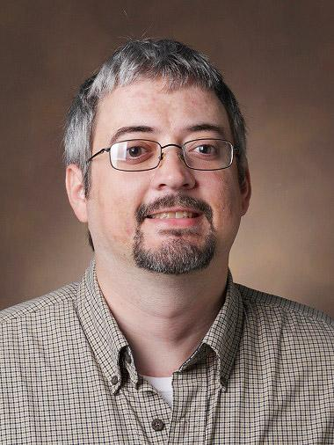
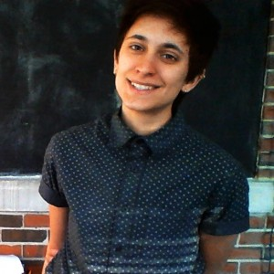
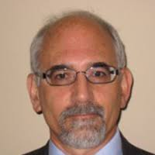
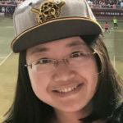
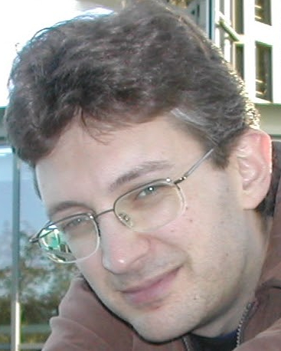
Meet the Instructors
Michael Kochen
Veronica Porubsky
Jin Xu
Joe Hellerstein
Lucian Smith

Slide 3
Where things are kept?
The primary drive for all material is at:
https://drive.google.com/drive/folders/13vo80577RDURPWtTOnFTiBit5duIVfKo?usp=sharing
Add it to chat.

Slide 4
What things are there in the Google Drive?
Cheat sheets on modeling and Tellurium
Tellurium in a Nutshell
A folder for each section
Scripts, ppts and exercises

Slide 5
Sources of Information
tellurium.analogmachine.org
https://tellurium.readthedocs.io/
Cheat sheets and other documents on the google drive

Slide 6
Topics for the Day
Session time and topic | Instructor
9 - 10 AM PT: Introduction to biochemical modeling (kinetic models), Python basics, Tellurium and Antimony | Dr. Herbert Sauro
10 - 11 AM PT: Michaelis-Menten kinetics, metabolic networks with examples | Dr. Michael Kochen and Dr. Herbert Sauro
11 - 12 PM PT: Parameter fitting for kinetic models | Dr. Joseph Hellerstein
12 - 1 PM PT: Lunch/ break
1 - 2 PM PT: Introduction to BioModels and systems biology standards, SBML diagrams (Lucian Smith and Jin Xu) | Dr. Lucian Smith and Dr. Jin Xu
2 - 3 PM PT: Metabolic control analysis (Herbert Sauro) | Dr. Herbert Sauro
3 - 4 PM PT: Personal project development and open forum | All instructors, Dr. Veronica Porubsky moderates

Slide 7
The Software
There are a number of tools you can use for simulation. All are compatible with SBML which is a common exchange format. In that sense it doesn't matter which tool you use.
Today we will use our Python tool call Tellurium
You can run this from the desktop or the web
On the web we will use Google’s colaboratory which is a Jupyter notebook

Slide 8
The Software
Python environments we can recommend include:
Spyder https://www.spyder-ide.org/
Installer at https://github.com/sys-bio/tellurium
pyCharm: https://www.jetbrains.com/pycharm/
Visual Studio Code https://code.visualstudio.com/docs/languages/python
Thorny https://thonny.org/
Thorny is relatively new and is a self-contained python environment.

Slide 9
Intro to Python and Modeling
Introduction to Python
Loading the simulator and utilities
Building and simulating models
Build a simple model of a linear chain
Run a time course
Change values
Reset the model
Compute the steady state

